Slide 1

LEARN PROGRAMMING WITH
KELVIN
+6281219644314
kelvindsmn@gmail.com

Slide 2
MATERIAL
In this course we will learn about the following concepts :
Expression
Arithmetic

Slide 3
EXPRESSION
EXPERSSION | MEANING
X + Y | X added to y, if x and y are number X concatenated to y, if x and y are strings
X – Y | X take away y, if x and y are numbers
X * Y | X times y, if x and y are numbers X concatenated with itself y times, if x is a string and y is integer Y concatenated with itself x times, if y is a string and x is integer
X / Y | X divided by y, if x and y are numbers
X % y | Remainder of x divided by y, if x and y are numbers
X ** y | X raised to y power, if x and y are numbers

Slide 4
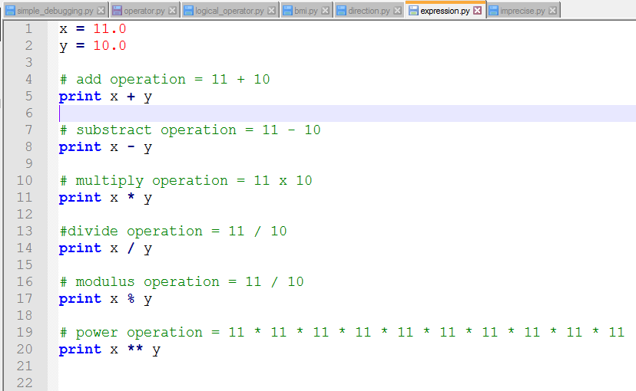
EXPRESSION

Slide 5
PRECEDENCE
2 + 3 * 4

Slide 6
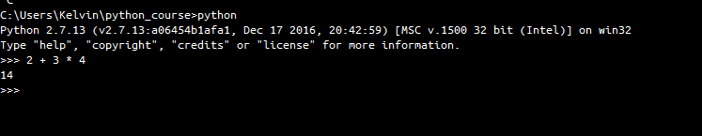
PRECEDENCE

Slide 7
ASSOCIATIVITY
ARITY | OPERATORS | ASSOCIATIVITY
UNARY | + -
BINARY | + / % | Left
BINARY | + - | Left
BINARY | = | Right

Slide 8
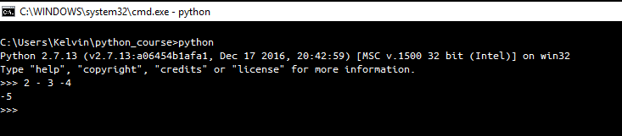
ASSOCIATIVITY

Slide 9
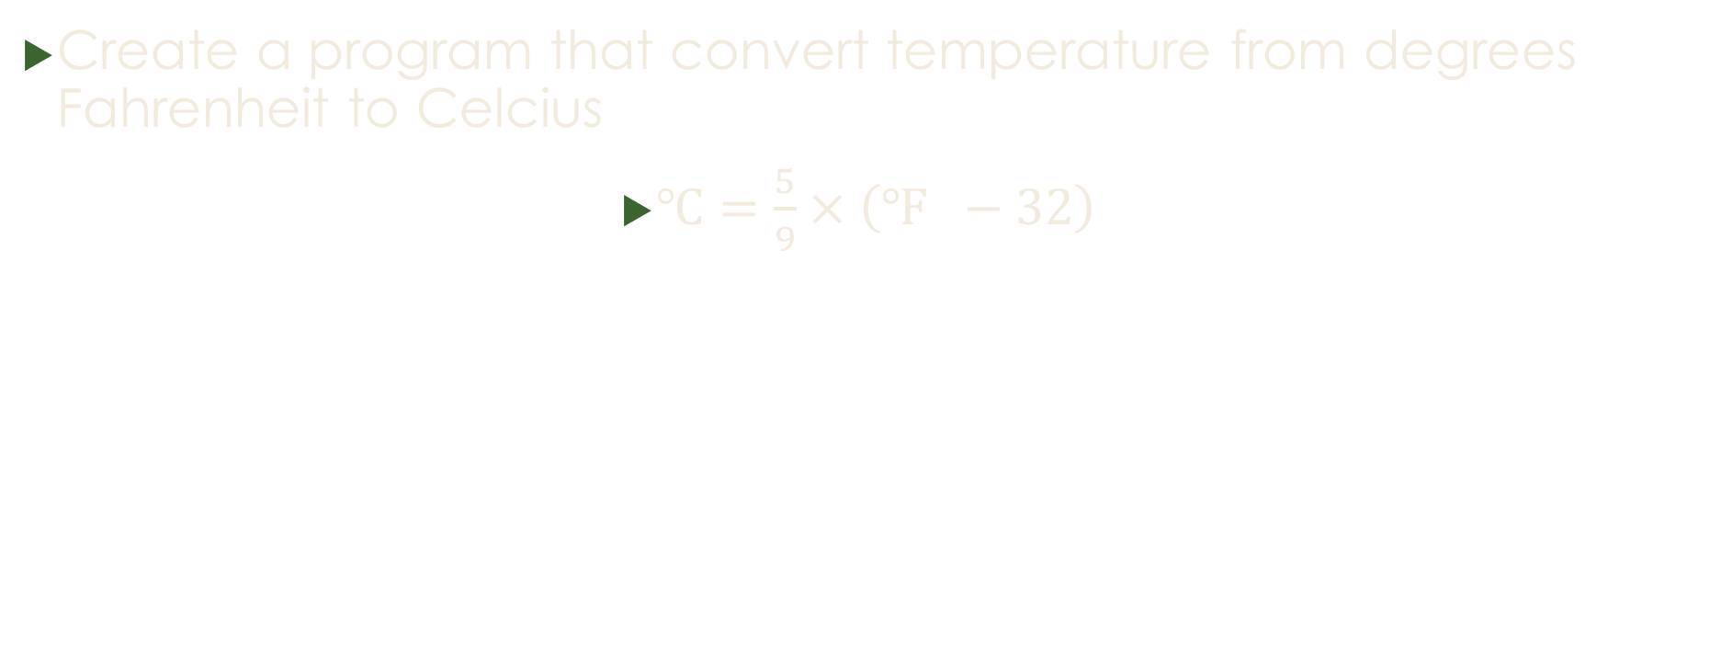
Temperature Converter
Create a program that convert temperature from degrees Fahrenheit to Celcius
$℃=\frac{5}{9}×\left(℉ −32\right)$

